Slide 1


SOCIAL BUZZ

Slide 2


Today's agenda
Project recap
Problem
The Analytics team
Process
Insights
Summary

Slide 3

Social Buzz is fast growing technology unicorn that need to adapt quickly to it’s global scale. Accenture has begun 3 month POC focusing on these tasks:
An audit of Social Buzz’s big data practice
Recommendations for a successful IPO
An analysis to find Social Buzz’s top 5 most popular content categories
Project Recap

Slide 4

Over 100000 posts per day
500 million users per month
36,500,000 pieces of content per year!
But how to analyse on it when there is so much?
An analysis to find Social Buzz’s top 5 most popular content categories
Problem

Slide 5



Andrew Fleming
Chief Technical Architect
The Analytics team
Marcus Rompton
Senior Principle
{Myself}
Data Analyst

Slide 6
Process
1
Data Understanding
2
Data Cleaning
3
Data Modeling
4
Data Analysis
5
Uncover Insights

Slide 7

Insights
Number of reactions are there to the most popular category
The month with the most posts
Number of unique content categories

Slide 8
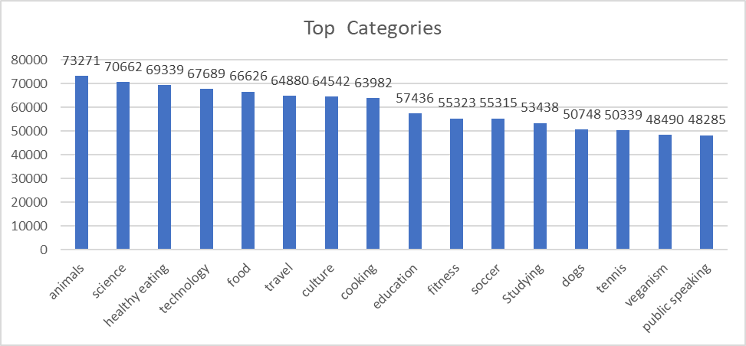
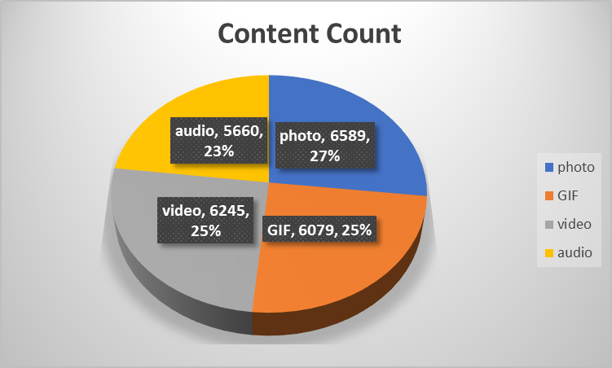
There are 16 unique content categories in Social Buzz
Photos are the most posted compared to others

Slide 9
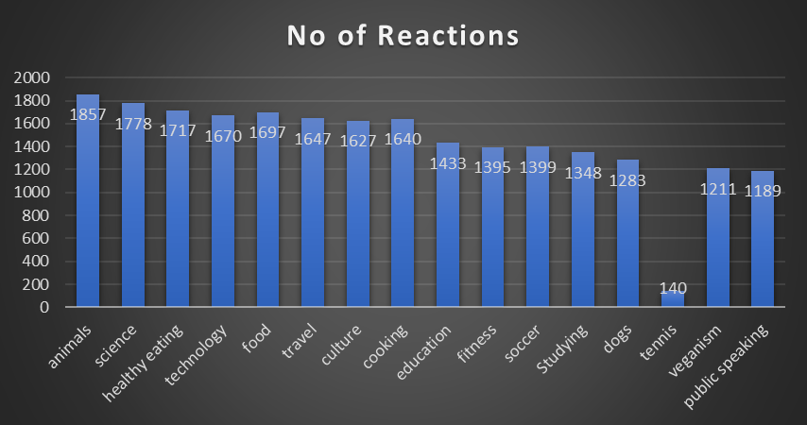
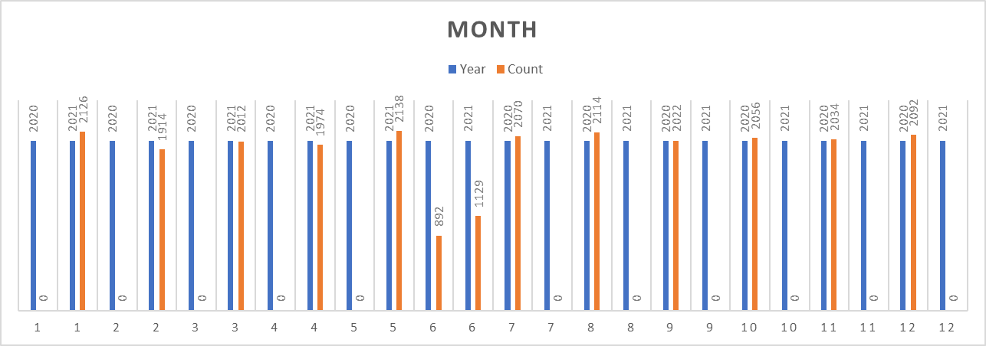
1857 Reactions are there to the most popular content category Animals
May 2021 is the month with the most posts

Slide 10

Social Buzz emphasizes content by keeping all users anonymous, only tracking user reactions. From the data insights, the most popular top 5 content categories are Animals, science, healthy eating, technology, food. We have analysed the most content type, number of reactions from the big data.
Summary

Slide 11
Thank you!

